Slide 1
Algorithms week 2-1: Text Analysis
Jonathan Stray
Columbia Lede Program
July 23, 2018
Notes:
To open:
Google n-gram viewer https://books.google.com/ngrams
Overview demo video https://blog.overviewdocs.com/2012/03/16/video-document-mining-with-the-overview-prototype/

Slide 2
Text Analysis in Journalism

Slide 3
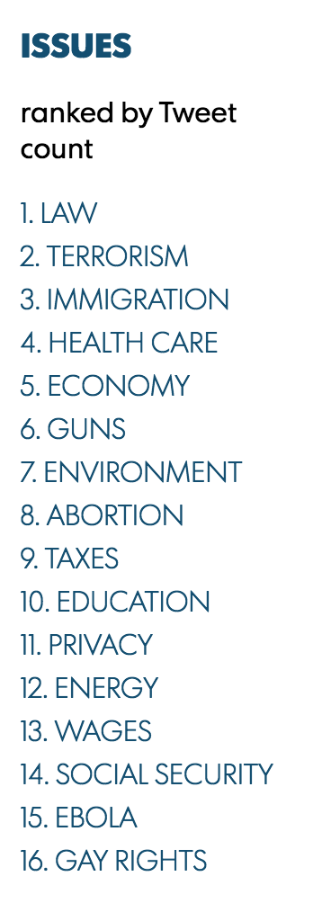
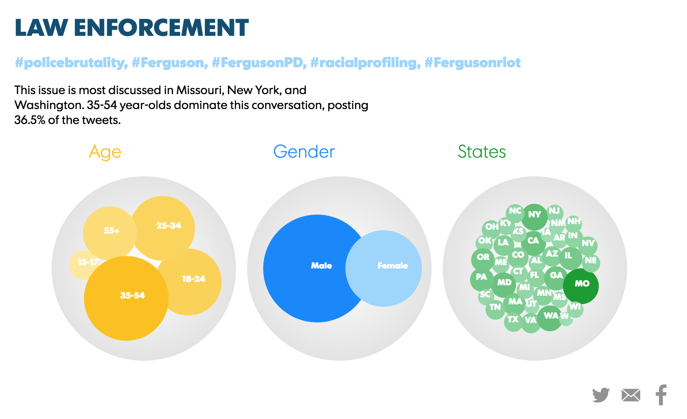
USA Today/Twitter Political Issues Index
Notes:
http://www.gannett-cdn.com/experiments/usatoday/2014/10/election-topics/

Slide 4
Twitter sentiment index
Post-match analysis of public attitudes on Twitter, University of Reading, 2015
Notes:
http://blogs.reading.ac.uk/reading-general-election-blog/2015/04/04/so-who-really-won-the-debate-post-match-analysis-of-public-attitudes-on-twitter/

Slide 5
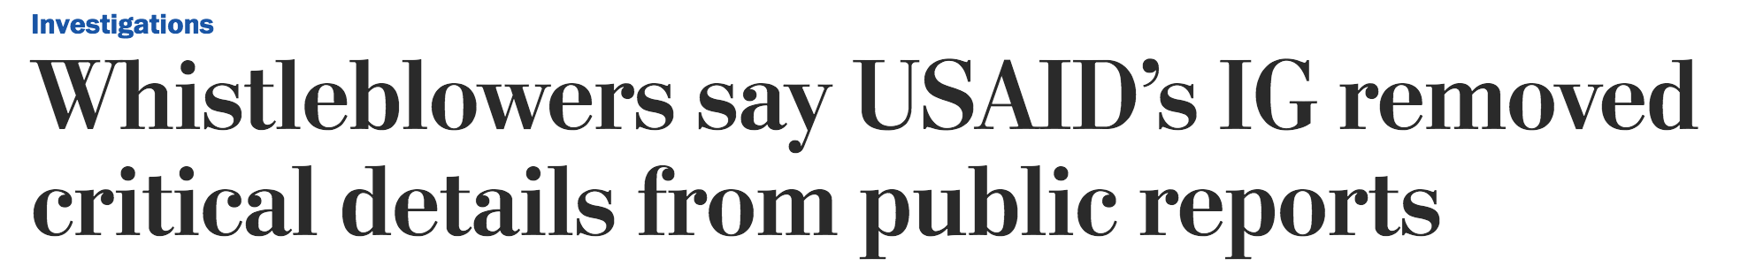
The Post obtained draft versions of 12 audits by the inspector general’s office, covering projects from the Caribbean to Pakistan to the Republic of Georgia between 2011 and 2013. The drafts are confidential and rarely become public. The Post compared the drafts with the final reports published by the inspector general’s office and interviewed former and current employees. E-mails and other internal records also were reviewed.
The Post tracked changes in the language that auditors used to describe USAID and its mission offices. The analysis found that more than 400 negative references were removed from the audits between the draft and final versions.
Sentiment analysis used by Washington Post, 2014
Notes:
https://www.washingtonpost.com/investigations/whistleblowers-say-usaids-ig-removed-critical-details-from-public-reports/2014/10/22/68fbc1a0-4031-11e4-b03f-de718edeb92f_story.html

Slide 6
We used a machine-learning method known as latent Dirichlet allocation to identify the topics in all 14,400 petitions and to then categorize the briefs. This enabled us to identify which lawyers did which kind of work for which sorts of petitioners. For example, in cases where workers sue their employers, the lawyers most successful getting cases before the court were far more likely to represent the employers rather than the employees.
The Echo Chamber, Reuters
Notes:
http://www.reuters.com/investigates/special-report/scotus/

Slide 7
Counting Words

Slide 8
Concordance: classical word counting
Notes:
http://www.ancient-hebrew.org/bible_concordance.html

Slide 9
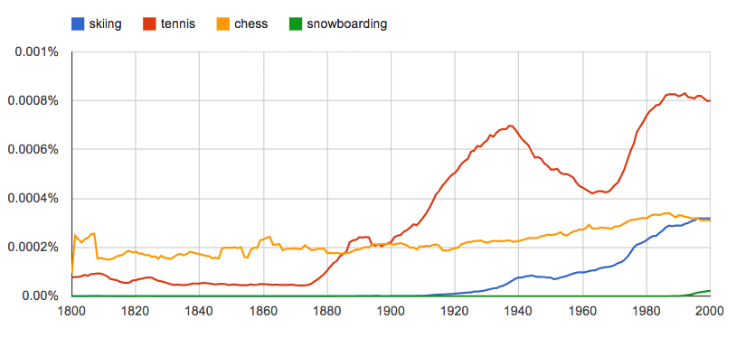
Google ngram viewer 12% of all English books

Slide 10
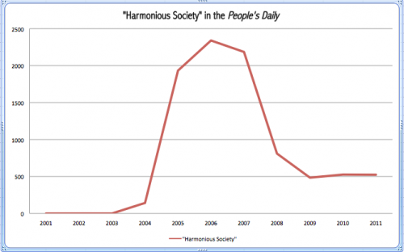
Stories from counting
When Hu Jintao came to power in 2002, China was already experiencing a worsening social crisis. In 2004, President Hu offered a rhetorical response to growing internal instability, trumpeting what he called a “harmonious society.” For some time, this new watchword burgeoned, becoming visible everywhere in the Party’s propaganda.
- Qian Gang, Watchwords: Reading China through its Party Vocabulary

Slide 11
Data can give a wider view
Let me talk about Downton Abbey for a minute. The show's popularity has led many nitpickers to draft up lists of mistakes. ... But all of these have relied, so far as I can tell, on finding a phrase or two that sounds a bit off, and checking the online sources for earliest use.
I lack such social graces. So I thought: why not just check every single line in the show for historical accuracy? ... So I found some copies of the Downton Abbey scripts online, and fed every single two-word phrase through the Google Ngram database to see how characteristic of the English Language, c. 1917, Downton Abbey really is.
- Ben Schmidt, Making Downton more traditional
Notes:
http://sappingattention.blogspot.com/2012/02/making-downton-more-traditional.html

Slide 12
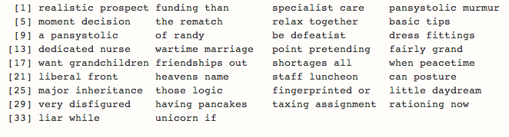
Bigrams that do not appear in English books between 1912 and 1921.

Slide 13
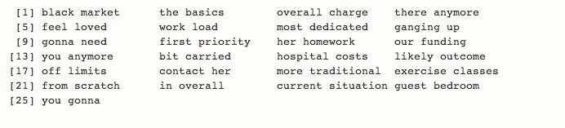
Bigrams that are at least 100 times more common today than they were in 1912-1921

Slide 14
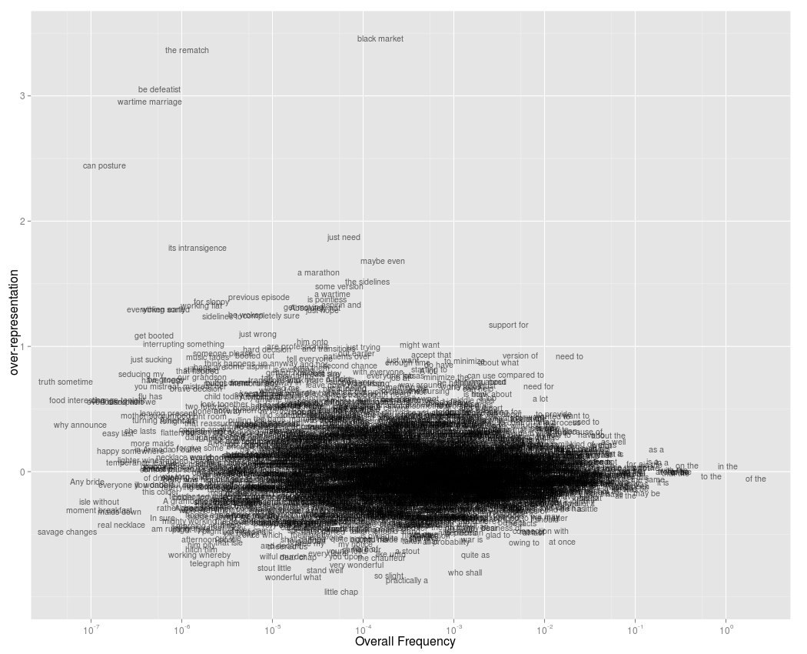

Slide 15
Document Vector Space Model

Slide 16
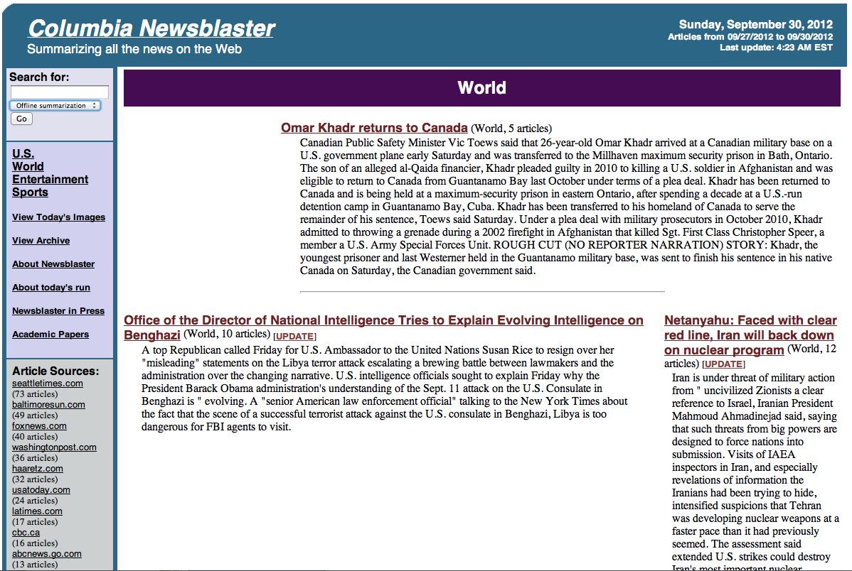

Slide 17
System Description
Scrape
Cluster
events
Cluster
topics
Summarize

Slide 18
What is this document "about"?
Most commonly occurring words a pretty good indicator.
30 the
23 to
19 and
19 a
18 animal
17 cruelty
15 of
15 crimes
14 in
14 for
11 that
8 crime
7 we

Slide 19
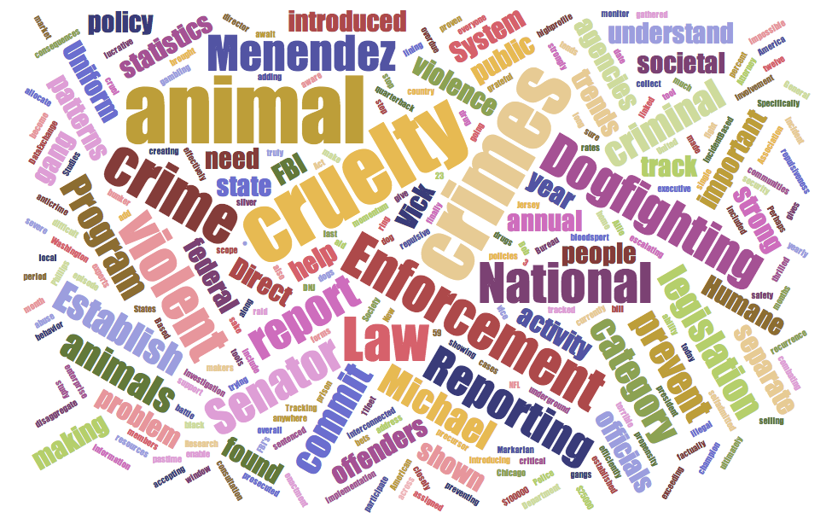

Slide 20
Map documents to vectors
Encode each document as the list of words it contains.
Dimensions = vocabulary of document set.
Value on each dimension = # of times word appears in document

Slide 21
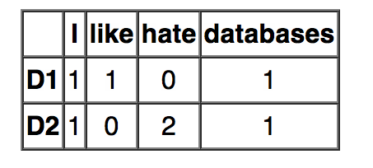
Example
D1 = “I like databases”
D2 = “I hate hate databases”
Each row = document vector
All rows = term-document matrix
Individual entry = tf(t,d) = “term frequency”

Slide 22
Aka “Bag of words” model
Throws out word order.
e.g. “soldiers shot civilians” and “civilians shot soldiers” encoded identically.

Slide 23
Tokenization
The documents come to us as long strings, not individual words. Tokenization is the process of converting the string into individual words, or "tokens."
For this course, we will assume a very simple strategy:
convert all letters to lowercase
remove all punctuation characters
separate words based on spaces
Note that this won't work at all for Chinese. It will fail in some ways even for English. How?

Slide 24
Distance function
Useful for:
clustering documents
finding docs similar to example
matching a search query
Basic idea: look for overlapping terms

Slide 25
Cosine similarity
Given document vectors a,b define
If each word occurs exactly once in each document, equivalent to counting overlapping words.
Note: not a distance function, as similarity increases when documents are… similar. (What part of the definition of a distance function is violated here?)

Slide 26
Problem: long documents always win
Let a = “This car runs fast.”
Let b = “My car is old. I want a new car, a shiny car”
Let query = “fast car”
 | this | car | runs | fast | my | is | old | I | want | a | new | shiny
a | 1 | 1 | 1 | 1 | 0 | 0 | 0 | 0 | 0 | 0 | 0 | 0
b | 0 | 3 | 0 | 0 | 1 | 1 | 1 | 1 | 1 | 1 | 1 | 1
q | 0 | 1 | 0 | 1 | 0 | 0 | 0 | 0 | 0 | 0 | 0 | 0

Slide 27
Problem: long documents always win
similarity(a,q) = 1*1 [car] + 1*1 [fast] = 2
similarity(b,q) = 3*1 [car] + 0*1 [fast] = 3
Longer document more “similar”, by virtue of repeating words.

Slide 28
Normalize document vectors
= cos(Θ)
returns result in [0,1]

Slide 29
Normalized query example
 | this | car | runs | fast | my | is | old | I | want | a | new | shiny
a | 1 | 1 | 1 | 1 | 0 | 0 | 0 | 0 | 0 | 0 | 0 | 0
b | 0 | 3 | 0 | 0 | 1 | 1 | 1 | 1 | 1 | 1 | 1 | 1
q | 0 | 1 | 0 | 1 | 0 | 0 | 0 | 0 | 0 | 0 | 0 | 0

Slide 30
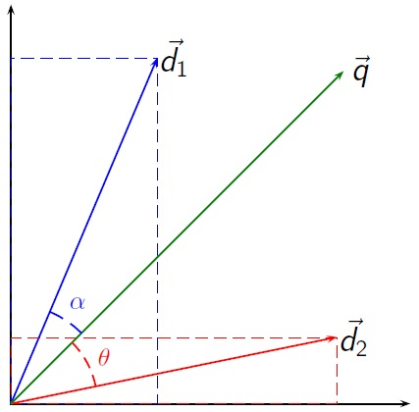
Cosine similarity

Slide 31
Cosine distance (finally)

Slide 32
Problem: common words
We want to look at words that “discriminate” among documents.
Stopwords: if all documents contain “the,” are all documents similar?
Common words: if most documents contain “car” then car doesn’t tell us much about (contextual) similarity.

Slide 33
Context matters
General News
Car Reviews
= contains “car”
= does not contain “car”

Slide 34
Document Frequency
Idea: de-weight common words
Common = appears in many documents
“document frequency” = fraction of docs containing term

Slide 35
Inverse Document Frequency
Invert (so more common = smaller weight) and take log

Slide 36
TF-IDF
Multiply term frequency by inverse document frequency
n(t,d) = number of times term t in doc d
n(t,D) = number docs in D containing t

Slide 37
TF-IDF depends on entire corpus
The TF-IDF vector for a document changes if we add another document to the corpus.
TF-IDF is sensitive to context. The context is all other documents
if we add a document, D changes!

Slide 38
What is this document "about"?
Each document is now a vector of TF-IDF scores for every word in the document. We can look at which words have the top scores.
crimes 0.0675591652263963
cruelty 0.0585772393867342
crime 0.0257614113616027
reporting 0.0208838148975406
animals 0.0179258756717422
michael 0.0156575858658684
category 0.0154564813388897
commit 0.0137447439653709
criminal 0.0134312894429112
societal 0.0124164973052386
trends 0.0119505837811614
conviction 0.0115699047136248
patterns 0.011248045148093

Slide 39
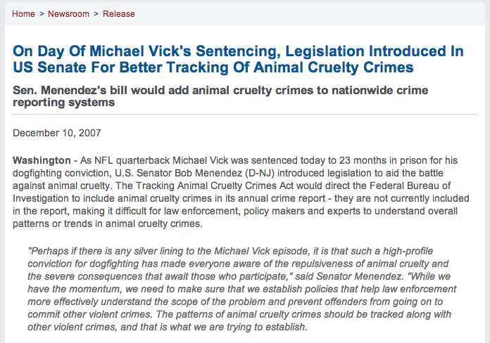
Notes:
https://www.menendez.senate.gov/news-and-events/press/on-day-of-michael-vicks-sentencing-legislation-introduced-in-us-senate-for-better-tracking-of-animal-cruelty-crimes

Slide 41
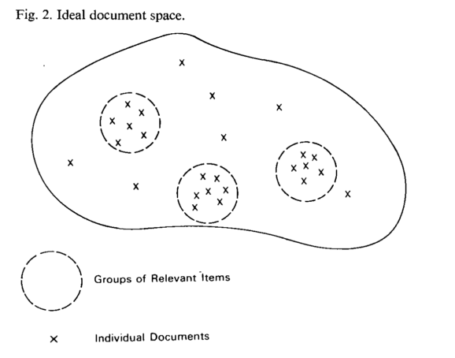
TF-IDF separates document clusters
A Vector Space Model for Automatic Indexing, Salton et al, 1975

Slide 42
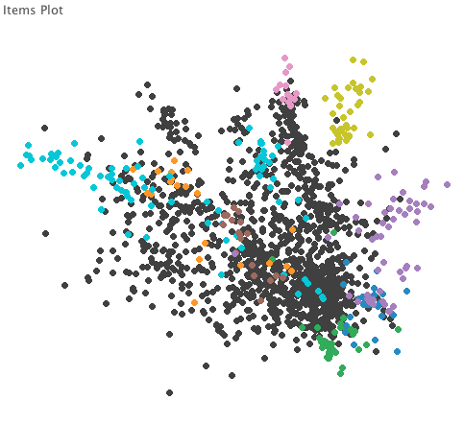
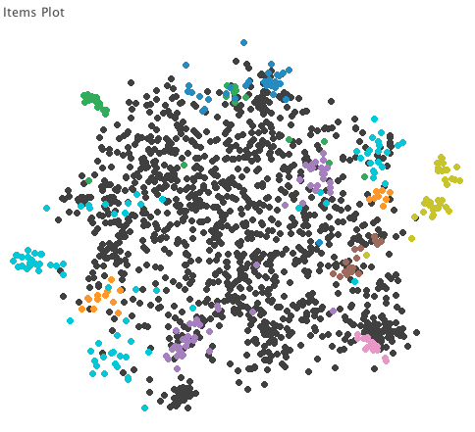
TF
TF-IDF
nj-senator-menendez corpus, Overview sample files
color = human tags generated from TF-IDF clusters

Slide 43
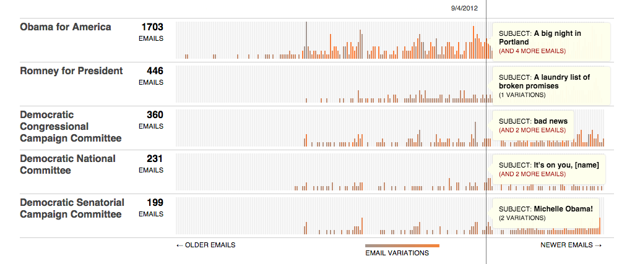
Message Machine
Jeff Larson, Al Shaw, ProPublica, 2012

